Slide 1

PROPELLENT 普瑞普勒
Heat exchanger used in various industries
换热器在各行业应用的推动者

Slide 2

我们是谁？
Propellent devotes to provide a heat transfer solution for civil and industrial users. It will extract wasted energy with the heat exchanger, to achieve energy conservation and emission reduction, meanwhile make use of waste heat and waste cold. We provide heating, cooling, waste heat recovery service, etc. Products we supplied include plate heat exchanger, plate condenser, air cooler, wide-runner plate heat exchanger, welded plate heat exchangers, heat-exchange unit, plate evaporator, air-handling system, water cooling equipment, waste heat recovery integration device, etc. Our service scope covers heating and air conditioning, chemical industry, food and beverage, sugar refinery, metallurgy, electric power, paper making, textiles, shipping and cooling areas, etc.
The superiority of Propellent’s hot and cold switching technology comes from its consist high attention to talent cultivation and product research. Propellent values group building and team building, pays attention to product performance & quality. Moreover, company has established developing funds and insurance funds, to provide sustainable development and guarantee for enterprise and employees. Propellent will also join the ranks to prompt trade and industry development.

Slide 3

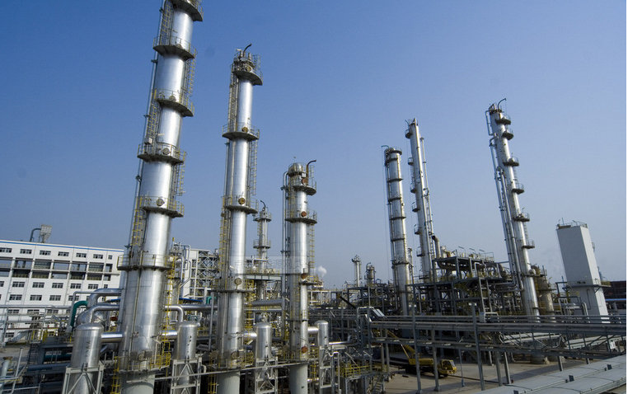
We serve for
Chemical Industry
Material cooling,
heating,
evaporation, condensation
Demineralization process,
heat recovery unit.

Slide 4
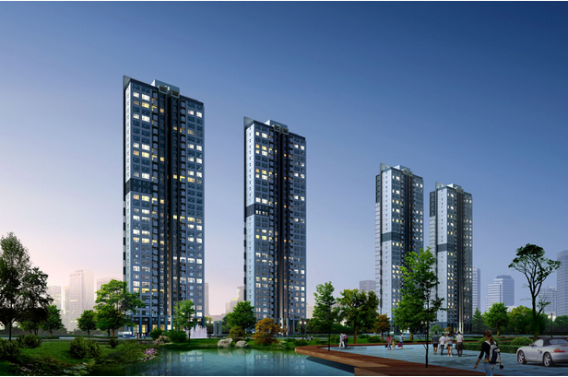
We serve for
Civil Industry
Residential area central heating,
central air conditioner,
cold-hot wind,
domestic water,
heat supply and etc.
Dilute station,
high temperature fan,
air compressor,
lubricating oil cooling

Slide 5
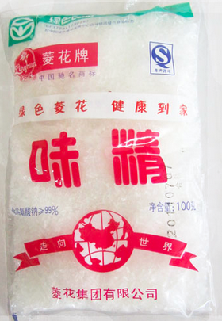

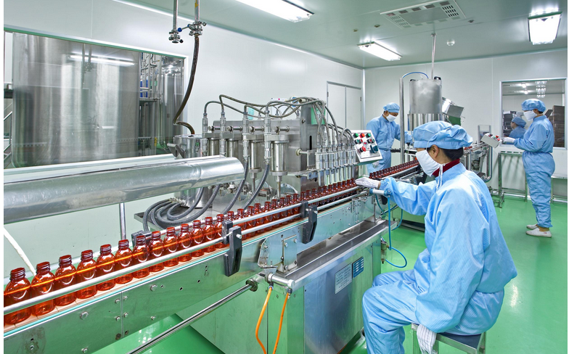
We serve for
Food and Drug
◆Cooling, evaporation, crystallization, sterilization
for the processing of liquid food
◆Heating, evaporation, condensation and sterilization for various Pharmaceuticals, pure water

Slide 6
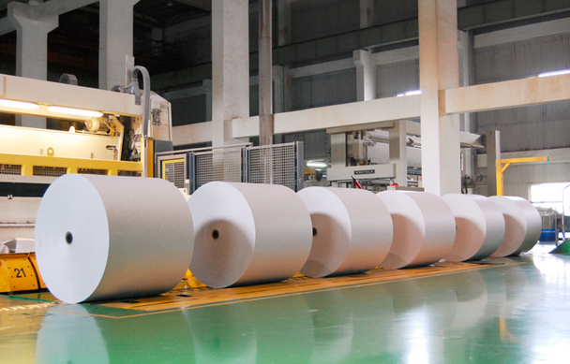
We serve for
Paper-making industry
Black liquor cooling，
pulp condensation
Heat recovery from
each process section.

Slide 7

We serve for
Electric Power Industry
◆Central cooling system；
◆Generator cooler；
◆Gear oil, lubricating oil cooling；
◆Transformer oil, Silicon rectifier pure water cooling.

Slide 8

We serve for
Petroleum Industry
◆Heating and cooling for various oil；
◆Condensation and cooling for column top gas；
◆Factory cooling water system；
◆Sea water cooling circulation of offshore drilling platform;
◆ Desalination unit、fresh water distillation、 heat recovery and cooling during triethylene glycol dehydration reaction.

Slide 9
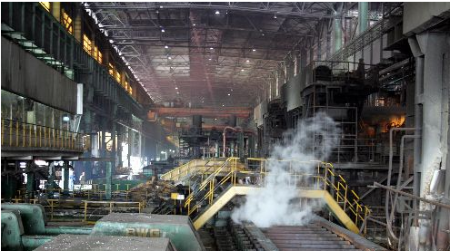
We serve for
Metallurgical Industry
◆Furnace body cooling；
◆Cooling for machinery equipment lubricant and gear oil；
◆Heating and cooling of electrolyte solution.

Slide 10
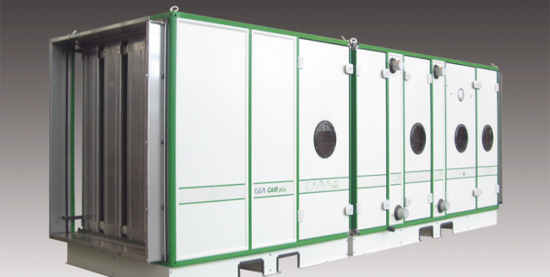
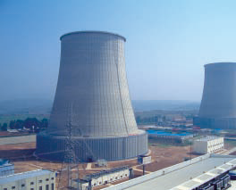
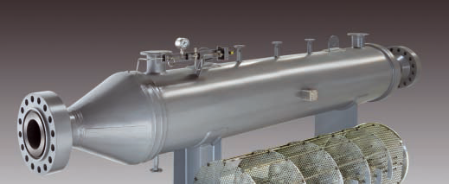
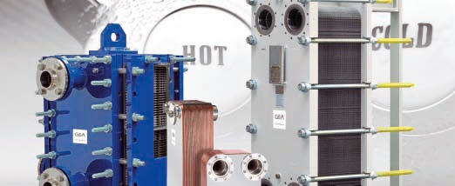
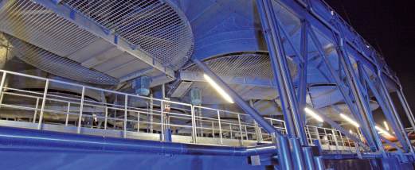
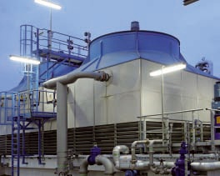
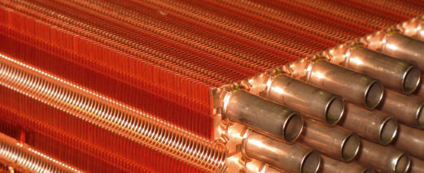
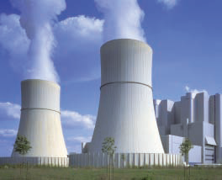
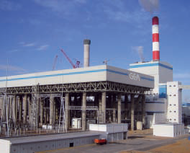
What We Can Provide

Slide 11
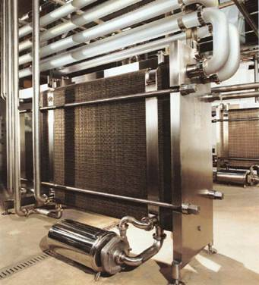
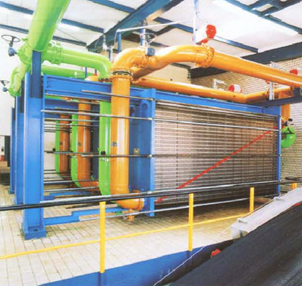
Gasket Type Plate Heat Exchanger

Slide 12
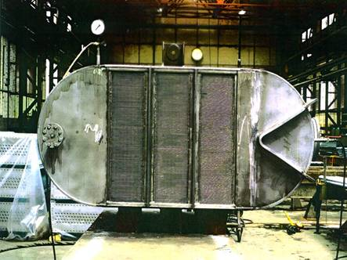
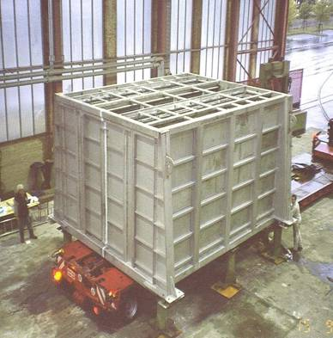
Welded Plate Heat Exchanger

Slide 13
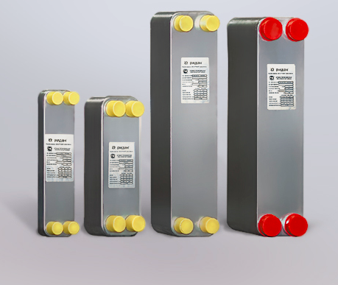
Brazing Plate Heat Exchanger

Slide 14
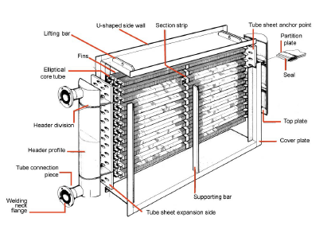
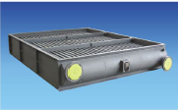
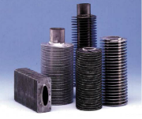
Finned-tube Heat Exchanger

Slide 15
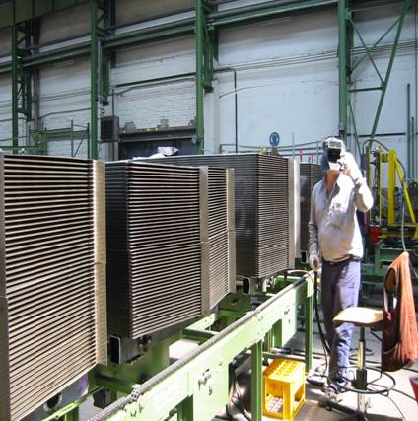
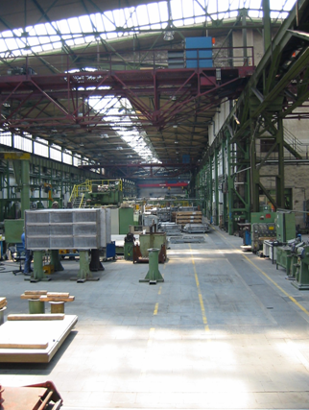
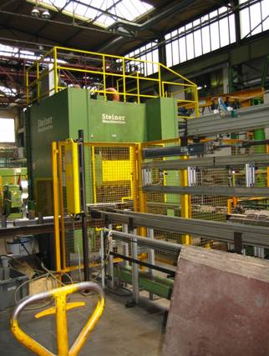
Production Capacity

Slide 16
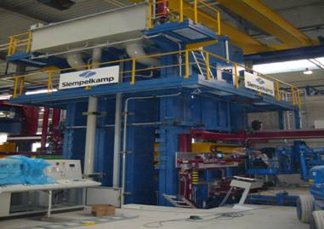
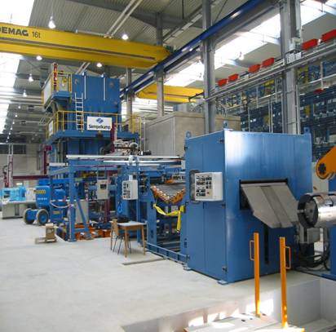
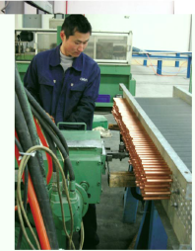
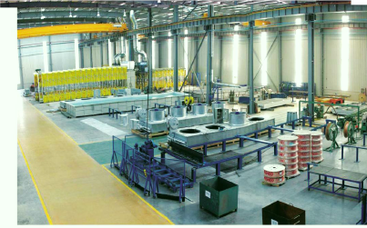
20000T
Press
Automatic Uncoiling
Finned tube Process

Slide 17
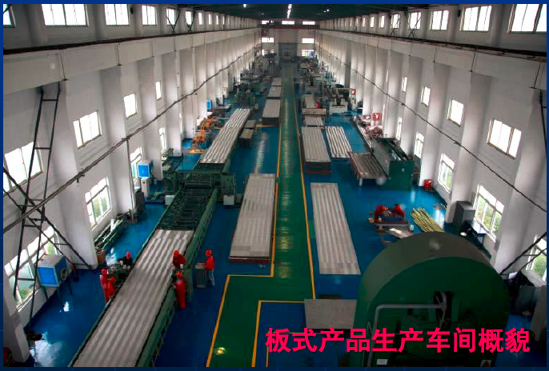
Workshop of Welded plate heat exchanger

Slide 18
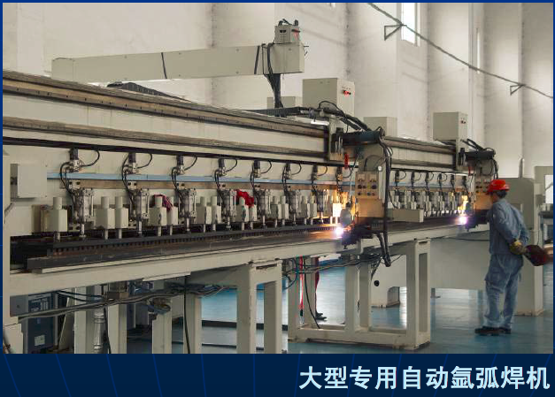
TIG WELDING MACHINES

Slide 19
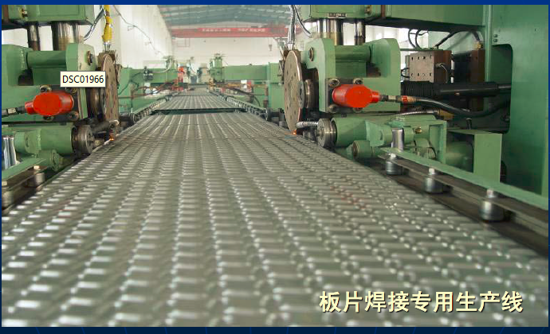
PRODUCT LINE OF SHEET WELDING

Slide 20
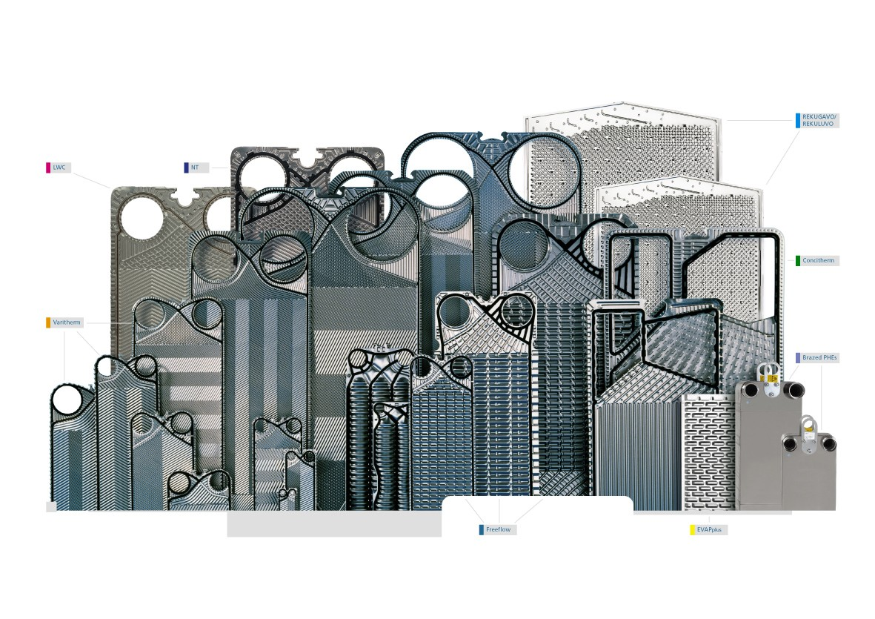
Plat and shell HE

Slide 21
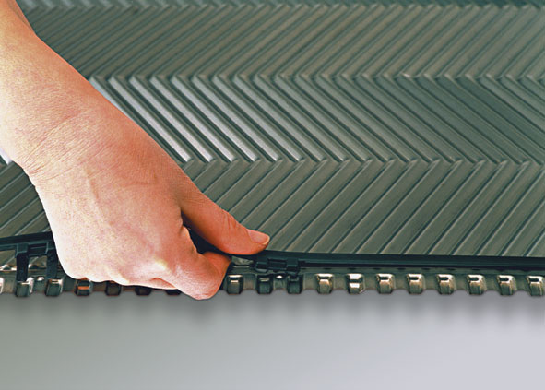
Plate & gasket material
Plate:
SS304 (1.4301)
SS316 (1.4401)
SS317 (1.4439)
SS904 (1.4539)
Titanium Gr.1
SMO 254
Alloy C-276
etc
Gasket:
Nitrile Rubber
High temperature nitrile rubber
EPDM
Viton E
Viton G
Viton GF
etc

Slide 22
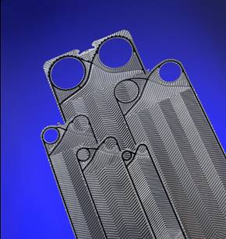
VT Series
VT series plate type is a core plate type imported from Germany Propellent , it can meet all the standard working condition. Each dimension of plate has 6 kinds of corrugation to ensure the heat exchange capacity, control pressure drop.

Slide 23
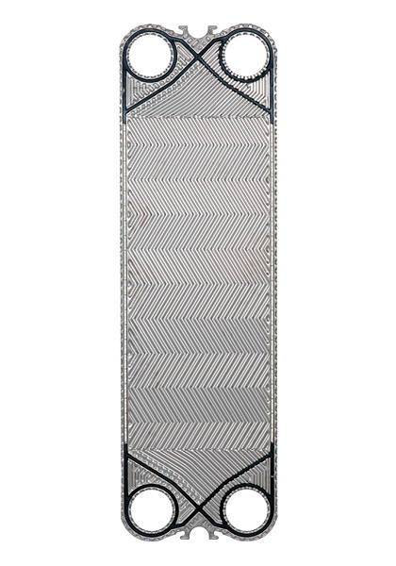
Metal connection point between plates
Fret groove
Plate shape– H, V
Heat transfer area: 0.05 m² (0,5 ft²) to 2.50 m² (27 ft²) for each plate
PHE flow reach to 3600 m3/h (15850 gpm)
Connection size: DN 25 (1”) to DN 500 (20”)

Slide 24
VT Characteristic and Advantage
Various Specification
Choose any of NBR、EPDM、Viton as gasket
Operating pressure reach to 25bar,test pressure reach to 32.5bar
Loc-in sealing system can work under flow rate from 5000kg/h to 100 000kg/h
SS frame can work under the flow rate from 500kg/h to100000kg/h
Sanitary condition comply with national standard

Slide 25
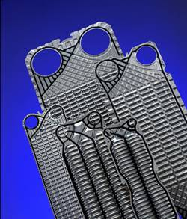

Wide Flow Path Free Flow Heat Exchanger
Free flow plate can used where the traditional is limited during design selection, the special point of this plate is that flow pass wide can reach to 12mm.
It can be used where chevron plate type is not suitable for special medium condition. With excellent heat exchange performance and characteristic of easy to remove and wash, it’s widely used in fermentation, sugar refinery, pharmacy, paper making, food and viscose industry etc.
12 mm free flow channel

Slide 26
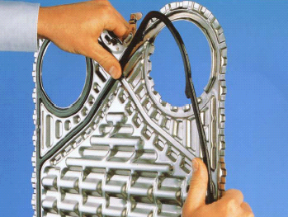
Characteristic and Advantage of Free Flow Series
Flow pass width 6mm or 12mm
Keep normal operating when the fiber length in the
medium is 10mm
Keep normal operating while particle size reach to5mm
Keep normal operating while particle content reach to 10%
Aequilatus flow pass can guarantee equipment run unobstructed
Compare to tube and spiral tube heat exchanger: low investment , less land occupation, low cost for maintainace.
Based on different requirement and condition, there are many choice for plate size, material and flow pass width.
Gasket material can be NBR or EPDM，some plate type can use VITON
Applicable for fiber and solid matter contained medium.

Slide 27
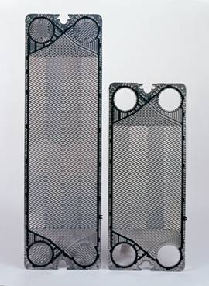
NT Series
  Fold increase plate length
  High performance flow distribution structure
  Automatic alignment plate system
  Non-gel EcoLoc washer

Slide 28
NT – High Performance Plate
To avoid uneven distribution of the fluid
Low Pressure Drop
High Heat Efficiency
Less Fouling

Slide 29
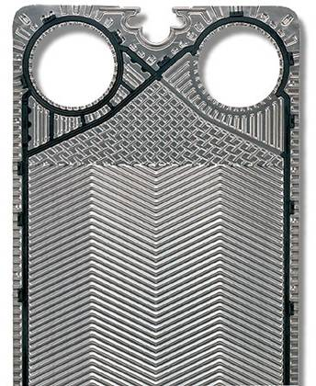
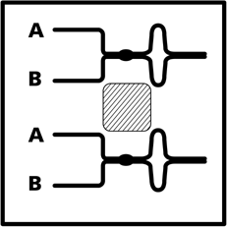
Semi-welded Applicable to Refrigeration Industry and Special Chemical Field
Principle:
  Two plates are joined by laser welding

Slide 30
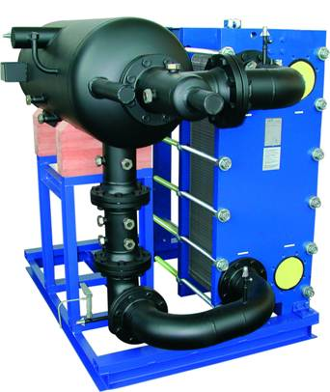
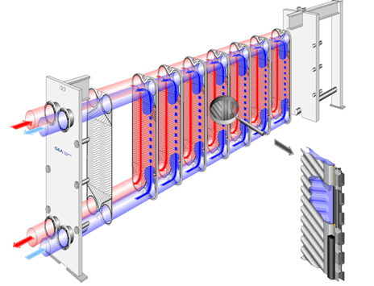

Plate Heat Exchanger Applicable to Industrial Refrigeration
应用 – 工业化制冷1

Slide 31
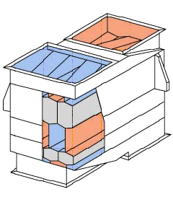
Welded Plate Heat Exchanger

Slide 32
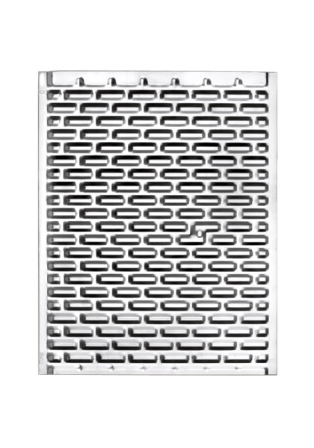
FULL WELDED PLATE HEAT EXCHANGER
Weldflex full welded plate heat exchanger is a plate heat exchange products,which integrated all advantage of detachable plate heat exchangers and shell-and-tube heat exchanger. its resistance high temperature, high pressure and high resistance corrosion ensures that can be replace most working condition of the traditional shell and tube heat exchanger. Weldflex full welded plate heat exchanger has a similar corrugated structure of detachable plate heat exchanger, meantime adopt more advanced full welding technology of sealing, no gasket design, the choice of materials with various metals and alloys to ensure that the full welded plate heat exchanger can be applied most of heat transfer working condition. the compactness constructure design, high efficiency heat transfer performance and versatile useing, which make full welded heat plate exchanfer is widely used in petrescence, heating,electricity,metallurgy, petrochemical and energy industries.

Slide 33
Characteristic of Welded Plate Heat Exchanger
Max. Working Temp.：600℃
Max. Working Pressure:5.0MPa
Max. Assembly Area：20000m2
Max. Nozzle Size：DN2000
Plate Thk. Range:0.6-1.0mm

Slide 34
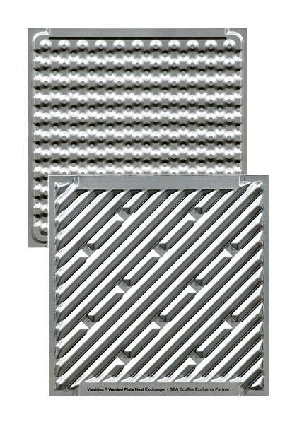
FULL WELDED PLATE HEAT EXCHANGER
Full welded plate heat exchanger consist of plates, side plates, columns, cover plate, pass partition, gaskets and other parts. the heat core is fully welded structure, heat core and frame are formed as one body by connect plate welding, side plate and cover plate as the main bearing components. cover plate and frame connect by bolts can easily open the cover plate to clean and repair. the biggest advantage is the all the parts of the heat exchanger are modular design, easy assembly, which able to provide economy of welded plate heat exchanger products for customer.

Slide 35
Welded Plate Heat Exchanger
Herringbone Corrugation Type
Bioconvex Corrugation Type
•Max. Working Temp.：700℃
•Max. Working Pressure：4.0MPa
•Max. Assembly Area：6000m2
•Max. Nozzle Size：DN600
•Plate Thk. Range：0.6-0.8mm

Slide 36
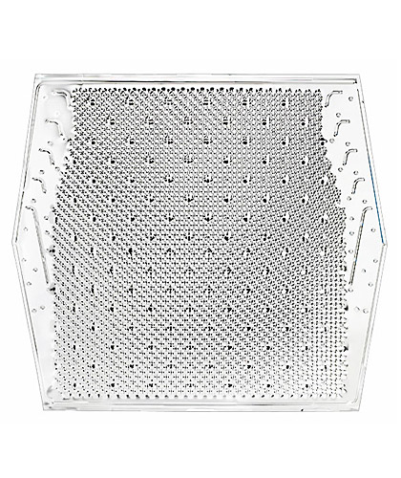
Propellent Welded Plate Heat Exchanger
•Max. Working Temp.：900℃
•Max. Working Pressure：0.2MPa
•Max. Assembly Area：200000m2
•Max. Nozzle Size：Any
•Plate Thk. Range：0.6-2.0mm

Slide 37
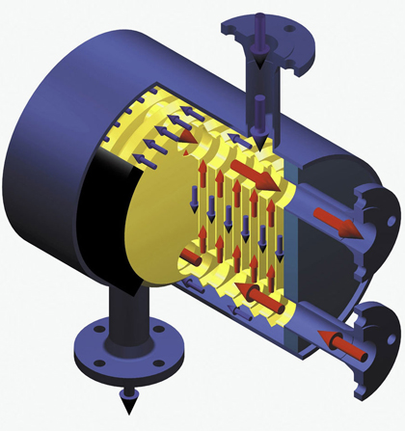
Propellent Plate Shell Heat Exchanger
。
•Max. Working Temp.：700℃
•Max. Working Pressure：6.0MPa
•Max. Assembly Area：400m2
•Max. Nozzle Size：DN350
•Plate Thk. Range：0.6-0.8mm

Slide 38
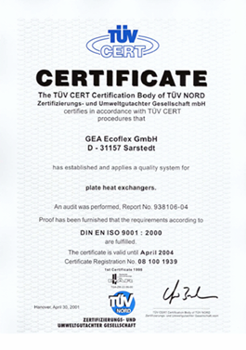

Quality Certification
Design Standard
  AD-2000
  ASME Section VIII Div.1
  PED 97/23/EC
  BS5500 Cat.1 or II
  …
Quality System
  DIN ISO 9001 certified
  ASME U-Stamp certified

Slide 39
  Efficient expenditure
  Complete product family
  High heat transfer efficiency
  Reliability
  Flexibility
  Simplified product architecture
  Compact
  Easy to repair
  High quality material
  Multi-purpose

Slide 40
Advantage on the plate design
High-performance fluid allocation model 1
Propellent Plate
Traditional Plate
Pass the plate with equivalent rate
Lower rate at this point, which decrease the performance

Slide 41
High-performance fluid allocation model 2
Different groove widths
create good fluid allocation
Cross section A-A
Cross section B-B
A
A
B
B
Wide Groove
Narrow Groove

Slide 42

High-performance fluid allocation model 3
Design by PROPELLENT, with wide diversion channels
Traditional, with narrow diversion channels
Wide diversion channels reduce the pressure drop

Slide 43

Automated location system Special design leads to reliable location
  easier repair
  a stable plate group
  prolong the seal ring life

Slide 44

NT –Series Detail Information
New non-gel “EcoLoc“ seal ring
  easy movement
  reduce replacement time
  reduce production pause

Slide 45

NT –Series Detail Information
New seal ring –Raised seal ring
  enter into adjacent groove
  easier to locate plate and seal ring
  stabilize the whole plates group

Slide 46

NT –Series Detail Information
New seal ring –
Raised seal ring
  enter into adjacent groove
  easier to locate plate and seal ring
  stabilize the whole plates group

Slide 47



PROPELLENT Herringbone
flow direction
flow direction
flow direction
horizontal/horizontal
horizontal/vertical
vertical/vertical

Slide 48

PROPELLENT Wide flow path

Slide 49




After-sales service
Adjustment & Cleaning
  Replace the sealing ring
    In our workshop
    Or your workshop if OK with you
  CIP – in-place cleaning
    in-place cleaning
    Use special cleaning medium for different dirt
    No need to unpack the heat exchanger

Slide 50

After-sales service
Spare parts
  We only use original spare parts – to make the heat exchanger normal working
  Special tools make repair easy
    Hydraulic wrench
    Ratchet wrench

Slide 51
Various kinds of spare parts
Alfa Laval
APV plate, gasket for plate heat exchanger
GEA plate, gasket for plate heat exchanger
TRANTER plate, gasket for plate heat exchanger
SONDEX plate, gasket for heat exchanger
VICARB plate, gasket for heat exchanger
HISAKA plate, gasket for heat exchanger
API / Schmidt plate, gasket for heat exchanger
Plate, gasket for heat exchanger made by Domestic manufacturer
Clamping bolt, gasket, lock washer for heat exchanger

Slide 52

Application Cases of Wide-Runner Plate Heat Exchanger
Cargil(Zibo)
To be used for cooling of culture medium
Heat exchange area: 197.1 ㎡
Model：BNF125
Hot side medium: starch slurry （60m³/h）
Continue to cool from 90℃ to 45℃
Viscosity at the entrance: 1.578089kg/ms
Viscosity at the exit: 3.287968kg/ms
Cooling medium: circulating cooling water （130㎡/h）
Heat up from 35℃ to 56.7℃, and then into cooling tower.

Slide 53

Application Cases of Wide Flow Pass Plate Heat Exchanger
Cargil(Zibo)
Wide-runner Free Flow Plate Heat Exchnager applies to cool medium
Heat transfer area: 93.6㎡ Type：BNF125
Hot side media, starch slurry
（60m³/h）
Cooling from 125℃ to 90℃，
Inlet Viscosity 1.000000kg/ms，
Outlet Viscosity 1.578089kg/ms；
Cooling media，Softening water（30㎡/h）
Heating from 23.5℃to 95℃，then into the boiler

Slide 54

Application Cases of Wide Flow Pass Plate Heat Exchanger
Zibo Deosen, For cooling medium Type：BNF125

Slide 55


Application Cases of Wide Flow Pass Plate Heat Exchanger
柠檬生化 柠檬酸废糖水余热回收 型号：BNF125

Slide 56

Application Cases of Wide Flow Pass Plate Heat Exchanger
Lemon Biochemical Recycle of Citric Acid Waste Syrup Waste Heat Type：BNF125

Slide 57

Application Cases of Wide Flow Pass Plate Heat Exchanger
Type：BNF200 Area 200㎡ Lemon Biochemical, Waste Syrup Heating fermentation liquor

Slide 58


Application Cases of Wide Flow Pass Plate Heat Exchanger
Type：BNF125 Ensign Industry Waste Syrup Cooling

Slide 59

专业团队为您的企业提供更加节能环保的热交换解决方案！
真诚期待与您的合作！

